Slide 1
DRS Conferences: a barometer and a mirror of theoretical design reflection
review and discussion on methodological approaches in 50 years
Alejandra Poblete P. | Associated Professor | Design School | apoblete@utem.cl

Slide 2
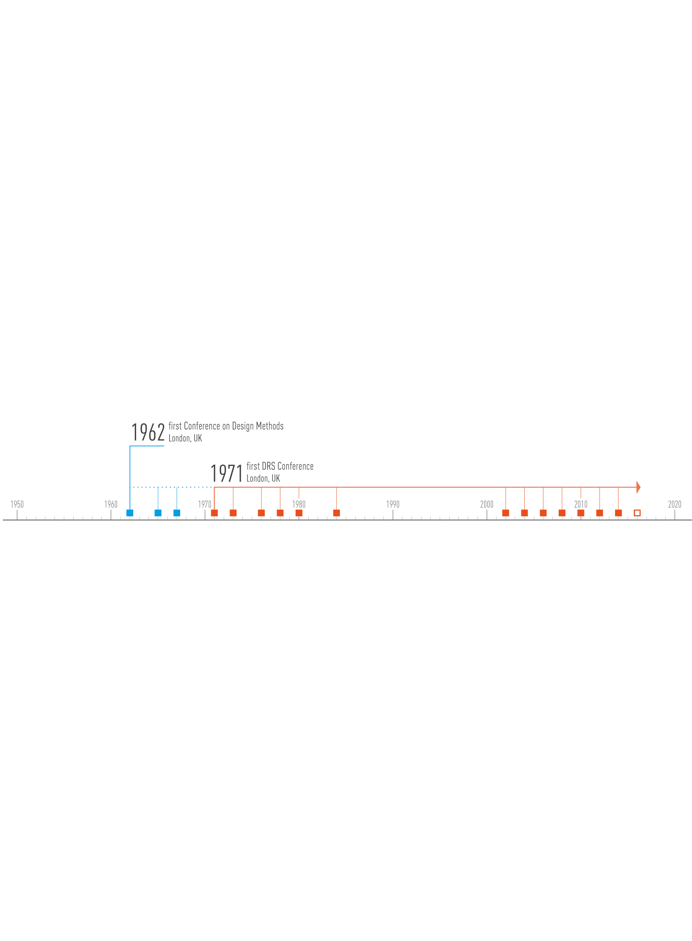
basic timeline of design methods conferences
Alejandra Poblete P. | Associated Professor | Design School | apoblete@utem.cl

Slide 3
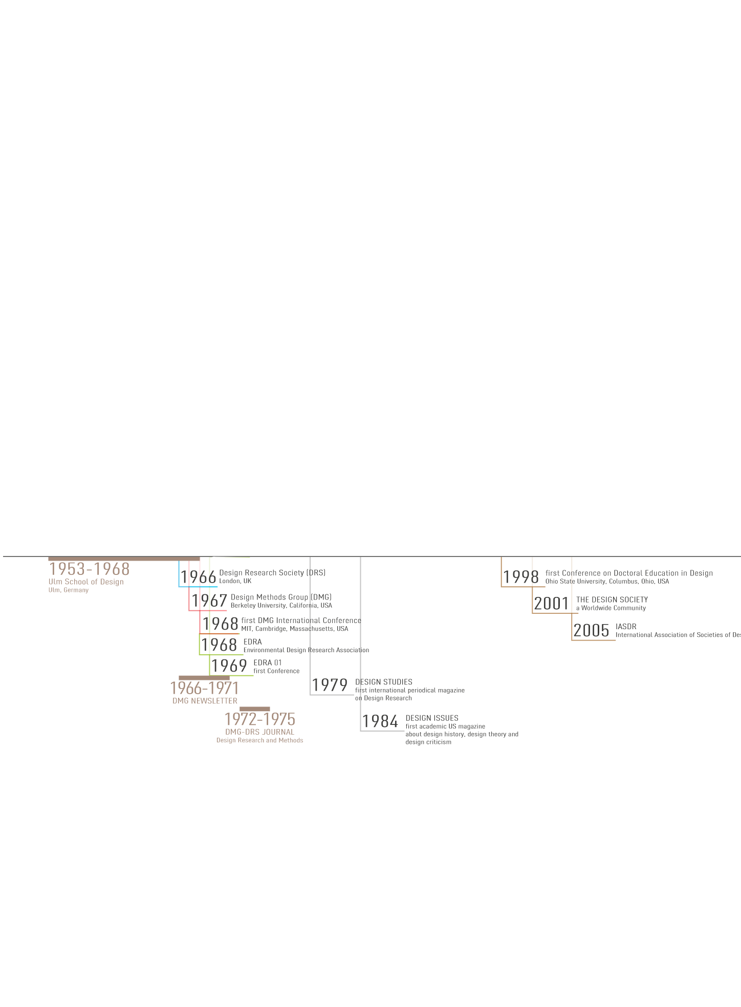
contextual and parallel design organisations, conferences and publications
Alejandra Poblete P. | Associated Professor | Design School | apoblete@utem.cl

Slide 4
…. design research in the Conferences: amount of works presented
Alejandra Poblete P. | Associated Professor | Design School | apoblete@utem.cl

Slide 5
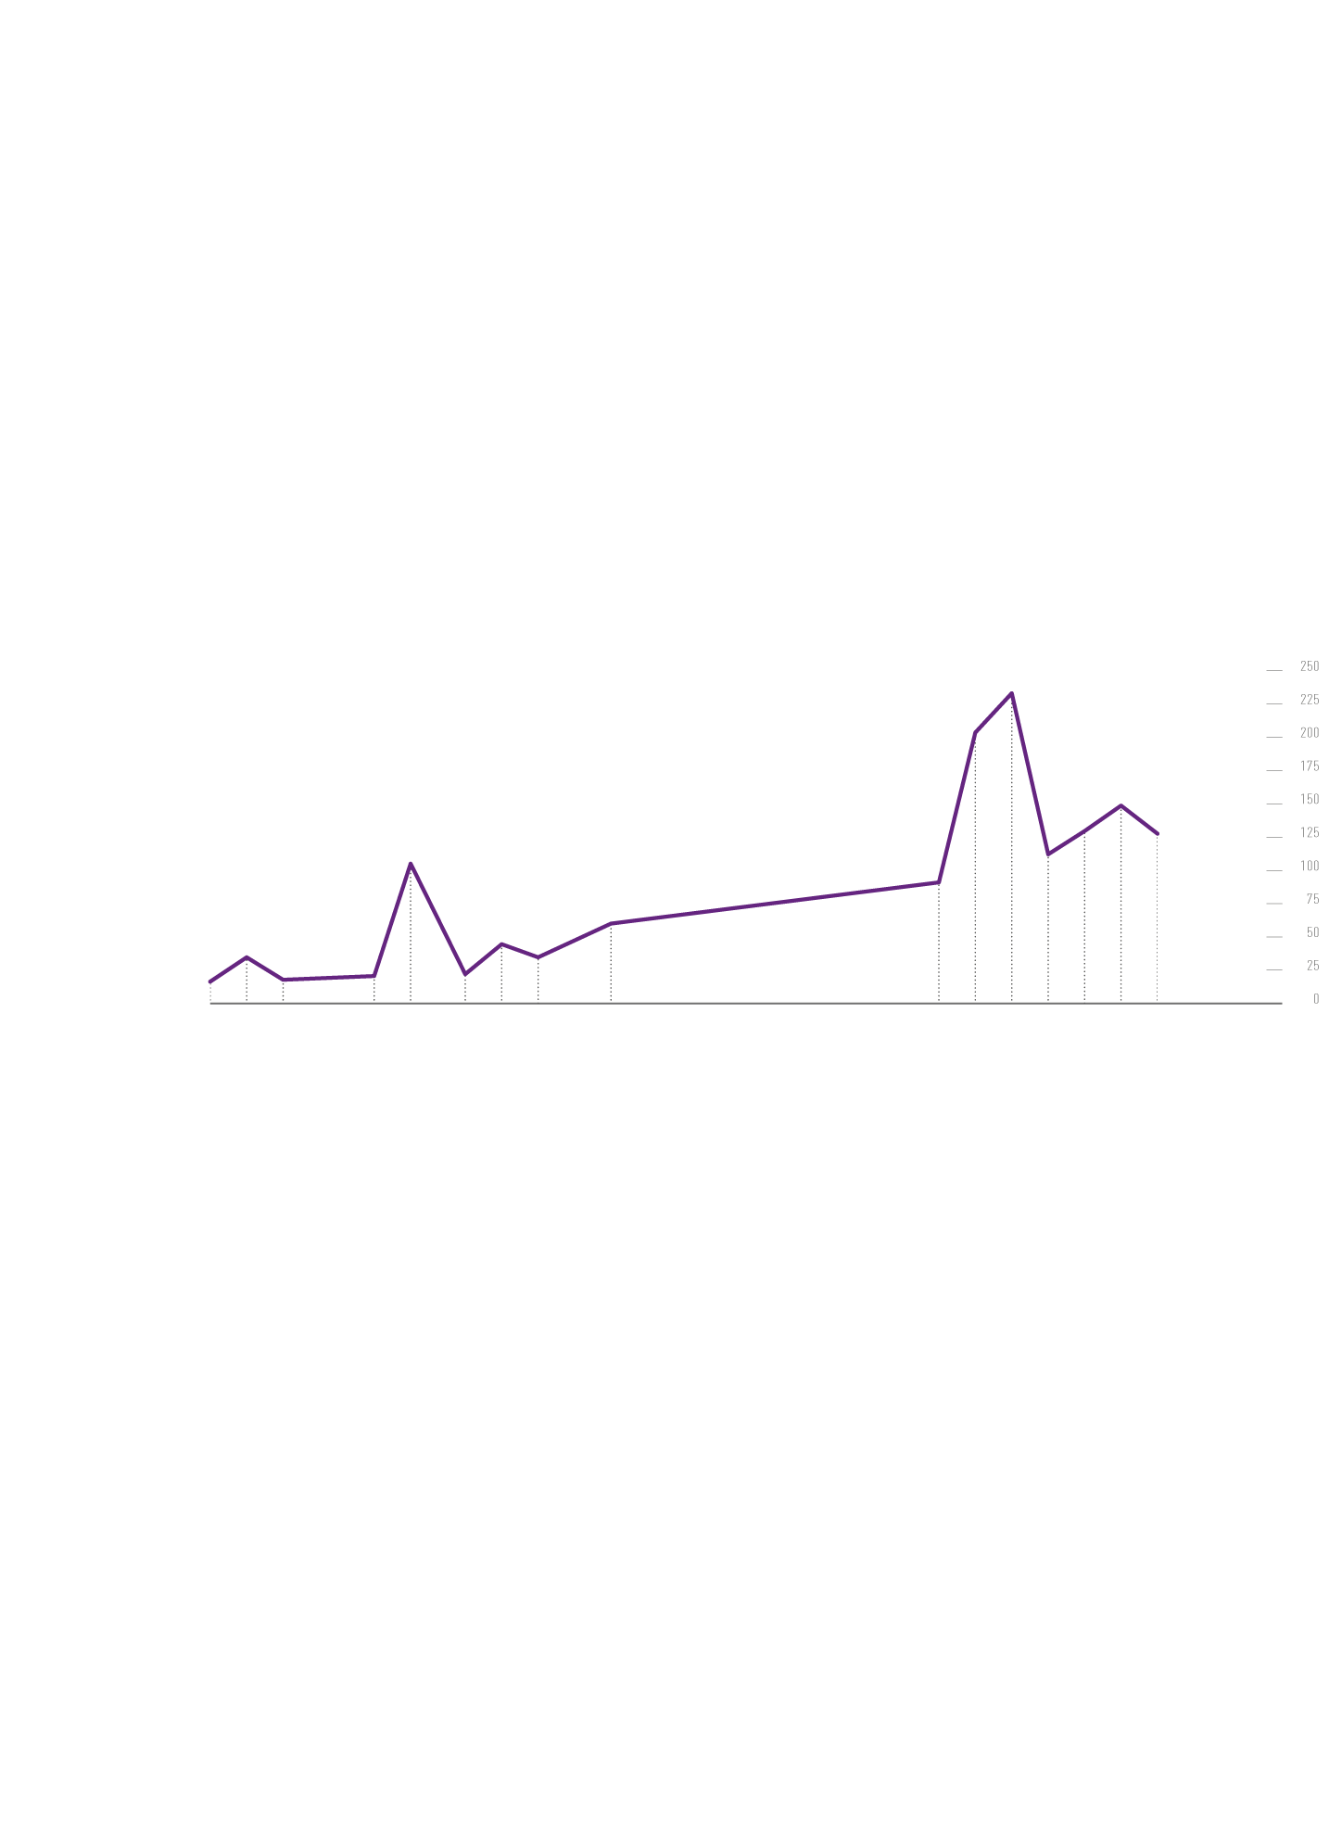
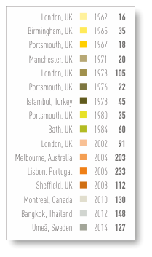
…. amount of works in each Conference
Alejandra Poblete P. | Associated Professor | Design School | apoblete@utem.cl

Slide 6
?
What kind of theoretical reflection is evidenced at each Conference?
Alejandra Poblete P. | Associated Professor | Design School | apoblete@utem.cl

Slide 7
praxiology
?
phenomenology
epistemology
applying the Archer’s taxonomy (1980)
Alejandra Poblete P. | Associated Professor | Design School | apoblete@utem.cl

Slide 8
praxiology
applying the Archer’s taxonomy (1980)
Alejandra Poblete P. | Associated Professor | Design School | apoblete@utem.cl

Slide 9
phenomenology
º
applying the Archer’s taxonomy (1980)
Alejandra Poblete P. | Associated Professor | Design School | apoblete@utem.cl

Slide 10
epistemology
applying the Archer’s taxonomy (1980)
Alejandra Poblete P. | Associated Professor | Design School | apoblete@utem.cl

Slide 11
praxiology
phenomenology
epistemology
the three lines of theoretical reflection
Alejandra Poblete P. | Associated Professor | Design School | apoblete@utem.cl

Slide 12
first Generation: Systems approach
praxiology
phenomenology
epistemology
Rittel’s Generations (1972)
Alejandra Poblete P. | Associated Professor | Design School | apoblete@utem.cl

Slide 13
second Generation: planning model
the “wicked” problems
praxiology
phenomenology
epistemology
Rittel’s Generations (1972)
Alejandra Poblete P. | Associated Professor | Design School | apoblete@utem.cl

Slide 14
the reflective gap?
praxiology
?
phenomenology
epistemology
a gap in the DRS Conferences
Alejandra Poblete P. | Associated Professor | Design School | apoblete@utem.cl

Slide 15
praxiology
phenomenology
epistemology
first Design PhD programs: EEUU, Australia, Europe, Japan (Saikaly, 2003)
Alejandra Poblete P. | Associated Professor | Design School | apoblete@utem.cl

Slide 16
praxiology
phenomenology
many more questions emerge…
epistemology
to be continued…
Alejandra Poblete P. | Associated Professor | Design School | apoblete@utem.cl

Slide 17
thanks
Alejandra Poblete P. | Associated Professor | Design School | apoblete@utem.cl

